Slide 1


Digital Portal Project
The Digital Portal project is designed to establish a centralized online platform that empowers users to effectively present their skills, projects, and experiences. In today's digital age, this platform will facilitate personal branding and professional networking, allowing individuals to connect and engage with a wider audience.

Slide 2



Student Information
Student Name
Register No and NMID
Email
Priyanka M
2422k1462
priyankamnm2422k1462@gmail.com
Department
College
BSc Computer Science
Government Arts and Science College, Sathyamagalam, Bharathiyar University

Slide 3







Digital Portfolio Project Overview(1)
Problem Statement
Project Overview
1
2
Identify the limitations of traditional resumes and the need for digital portfolios.
Outline the objectives and key features of the Digital Portal.
Features and Functionality
End Users
6
3
Highlight the core functionalities of the Digital Portal.
Define target users who will benefit from the digital portfolio platform.
Portfolio Design
Tools and Technologies
Describe the visual layout and design philosophy.
5
4
List the technologies used in developing the project.

Slide 4



Digital Portfolio Project Overview(2)
2
Conclusion
Summarize the project’s impact and future potential.
Results and Screenshots
1
Present outcomes and visual representation of the project.
GitHub Link
Provide a link for accessing the project code and documentation.
3

Slide 5




Digital Portfolios: A Solution for Visibility
1
Traditional Resumes Limit Visibility
2
Lack of Online Presence
3
Digital Portfolios Offer Solutions
Many students and professionals lack a structured online presence.
Traditional resumes often fail to effectively showcase skills and projects.
Digital portfolios provide a comprehensive view of skills and achievements.

Slide 6
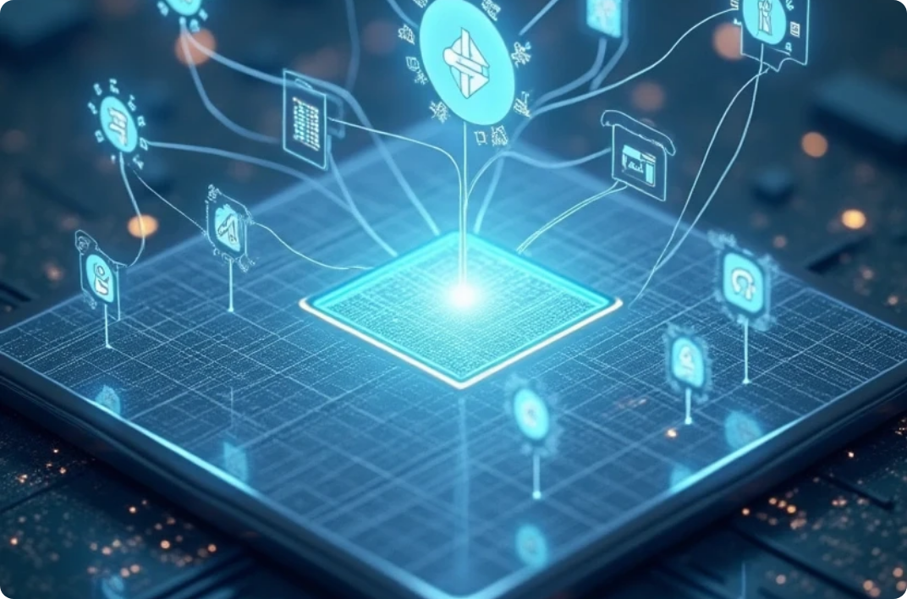
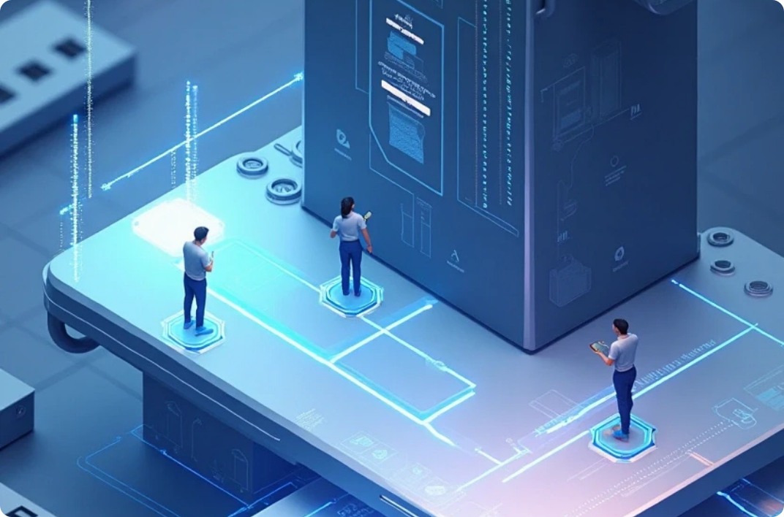
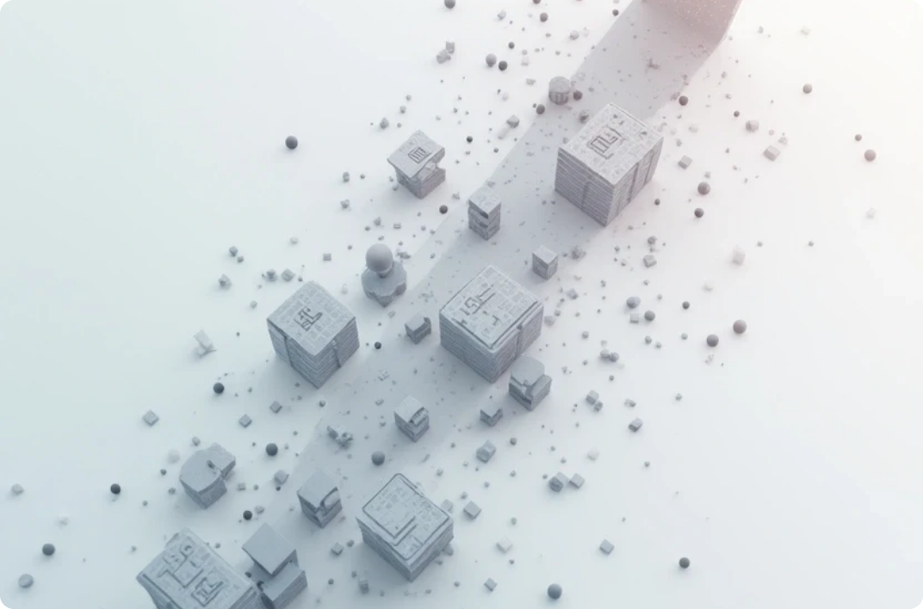
Digital Portal Project Overview
Centralized Access
Enhanced User Experience
Scalable Foundation
Users can access multiple digital services and resources from a single location, enhancing convenience.
The platform simplifies navigation and improves accessibility, making it user-friendly.
Built using HTML, CSS, and JavaScript, the project is designed to support future enhancements and updates.

Slide 7




End Users
Students
Professionals
Individuals seeking to showcase their academic achievements, projects, and skills to potential employers.
1
2
Those looking to present their work experience and portfolio to enhance career opportunities.
Employers
Educators
Recruiters and hiring managers who can use the platform to find qualified candidates.
4
3
Teachers who wish to provide a platform for students to display their projects and skills.

Slide 8



Tools and Technologies
1
HTML
2
CSS
For structuring the web pages and content of the Digital Portal.
To style the portal, ensuring a visually appealing and responsive design.
3
JavaScript
4
Frameworks
For implementing interactive features and enhancing user engagement.
Potential use of libraries like Bootstrap for responsive design and jQuery for simplified scripting.

Slide 9
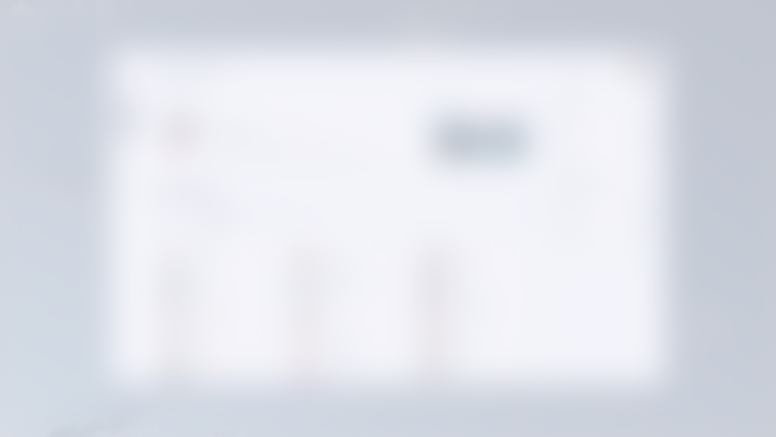

Features and Functionality
User Profiles
Project Uploads
Search Functionality
Users can create and customize profiles to showcase their skills and work.
Allows users to upload projects, documents, and multimedia to their portfolio.
Enables users to search for specific skills or projects within the portal.
Feedback System
Share Options
Users can receive feedback from peers and mentors on their projects.
Integrated sharing capabilities to promote portfolios on social media platforms.

Slide 10
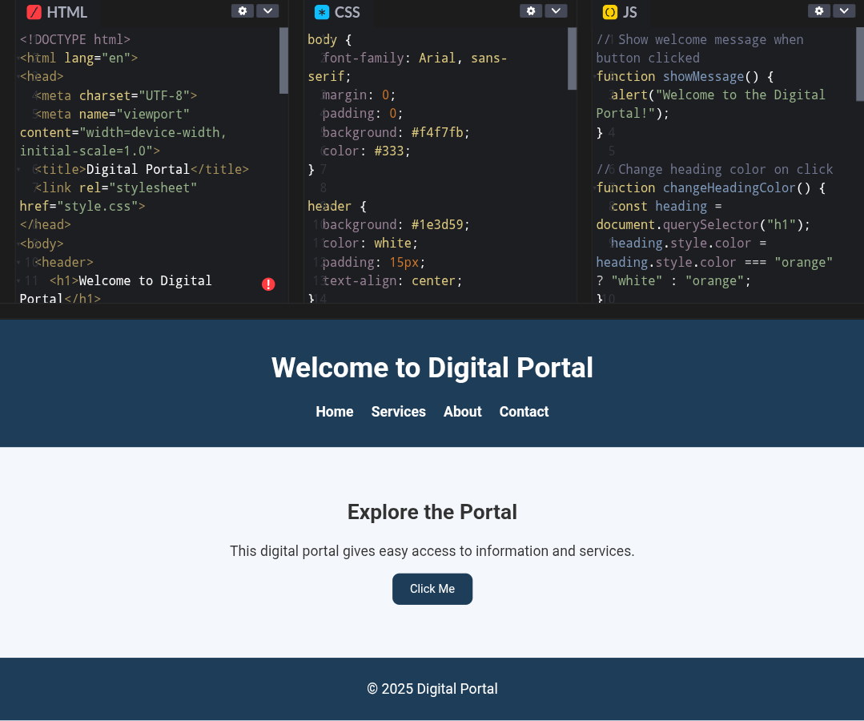
Results and Screenshots

Slide 11
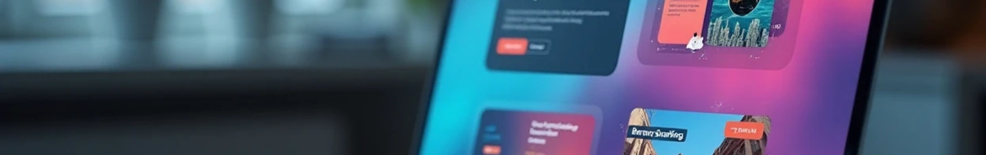


Conclusion of the Digital Portal Impact
1
Effective Platform
2
Enhanced Visibility
3
Future Developments
The Digital Portal effectively addresses the need for a modern platform for users.
Transitioning from traditional resumes to digital portfolios enhances user visibility.
Future developments will focus on feature expansion and user experience improvement.

Slide 12
GitHub Repository for Digital Portal Project
Visit Repository
Get Source Code
Contribute to Project
Explore the Digital Portal project resources.
Access all the source code for the project.
Contributions and feedback are welcome.

